Slide 1
Topic: Back to Back Stem and leaf plots EQ: How can I use Stem and Leaf Plots to compare two sets of data ?
Year 11 Essentials

Slide 2
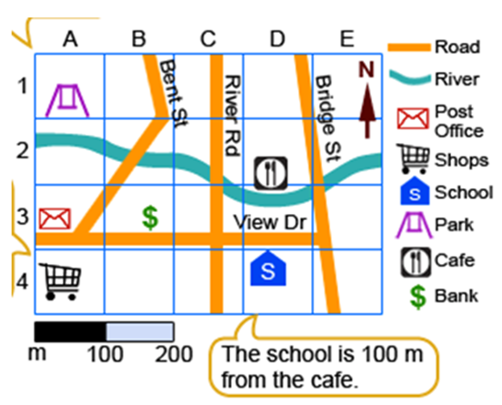
Five Questions
Topic: Back to Back Stem and Leaf Plots
EQ – How can I use Stem and Leaf Plots to compare two sets of data ?
1) Read the scale to estimate the real life distance between the Shops and the School
2) Peter’s mum is driving 400 km down South to visit his Grandma. If the trip takes her 4 hours, what was her average speed for the journey?
3) 3 tennis racquets cost $360 in total. How much would 5 racquets cost?
4) Sacha wants to paint her garden fence of area 60 m². A 5 litre can of paint can cover 12 m². How many litres of paint does she require?
5) A swimming pool is 5000 cm long, 2000 cm wide and 1500 cm in depth. Calculate the volume of the swimming pool in litres.

Slide 3
24
7
30
Topic: Back to Back Stem and Leaf Plots
Date: XX/XX/2021
EQ – How can I use a stem and leaf plot to compare two sets of data
What are back to back
Stem and Leaf Plots?
Back to back stem and leaf plots are used to display two different groups of data together in the one plot.
The groups are displayed separately but share a common stem.
One group is displayed on the left hand side, the other on the right hand side.
WICOR

Slide 4
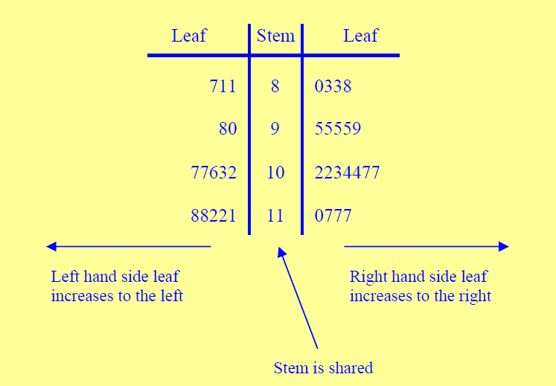
24
7
30
Topic: Back to Back Stem and Leaf Plots
Date: XX/XX/2021
EQ – How can I use a stem and leaf plot to compare two sets of data
What are back to back
Stem and Leaf Plots?
The groups are displayed separately but share a common stem.
One group is displayed on the left hand side, the other on the right hand side.
WICOR

Slide 5
Say we have the times for 20 male runners in the 100m:
10.8, 10.5, 11.3, 12.6, 13.1, 11.1, 11.2, 11.7, 11.2, 13.0, 12.3, 11.8, 11.5, 10.9, 10.7, 11.0, 11.1, 11.1, 12.1, 14.3
When we put this data in a stem and leaf plot, it looks like this:
Stem
Leaf
Stem
Leaf
10 8 5 9 7
3 1 2 7 2 8 5 0 1 1
12 6 3 1
13 1 0
14 3
10 5 7 8 9
0 1 1 1 2 2 3 5 7 8
12 1 3 6
13 0 1
14 3
Ordered
KEY
10|5 = 10.5 secs

Slide 6
20 women also ran 100m and their results are shown in the stem & leaf diagram below.
Stem
Leaf
Stem
Leaf
11 5 9
12 3 5 5 5 6 7 9 9
13 0 0 1 3 4 8 8
14 4 7
15 0
10 5 7 8 9
0 1 1 1 2 2 3 5 7 8
12 1 3 6
13 0 1
14 3
KEY
11|9 = 11.9 secs

Slide 7
24
7
30
Topic: Back to Back Stem and Leaf Plots
Date: XX/XX/2021
EQ – How can I use a stem and leaf plot to compare two sets of data
Individually, it can be hard to compare the two data sets; it is just a bunch of numbers. That is where back-to-back stem and leaf plots are useful.
When comparing two sets of data, it is often more useful to draw a back-to-back stem & leaf plot
Back-to-Back stem & leaf diagrams share the same ‘stem’
Numbers closest to the ‘stem’ are smaller
WICOR

Slide 8
Comparing the performances of the 20 men and women runners with a back to back stem and leaf gives us a better visual comparison.
WOMEN
MEN
Leaf
Stem
Leaf
9 5
9 9 7 6 5 5 5 3
8 8 4 3 1 0 0
7 4
0
10 5 7 8 9
0 1 1 1 2 2 3 5 7 8
12 1 3 6
13 0 1
3
KEY
11|9 = 11.9 secs

Slide 9
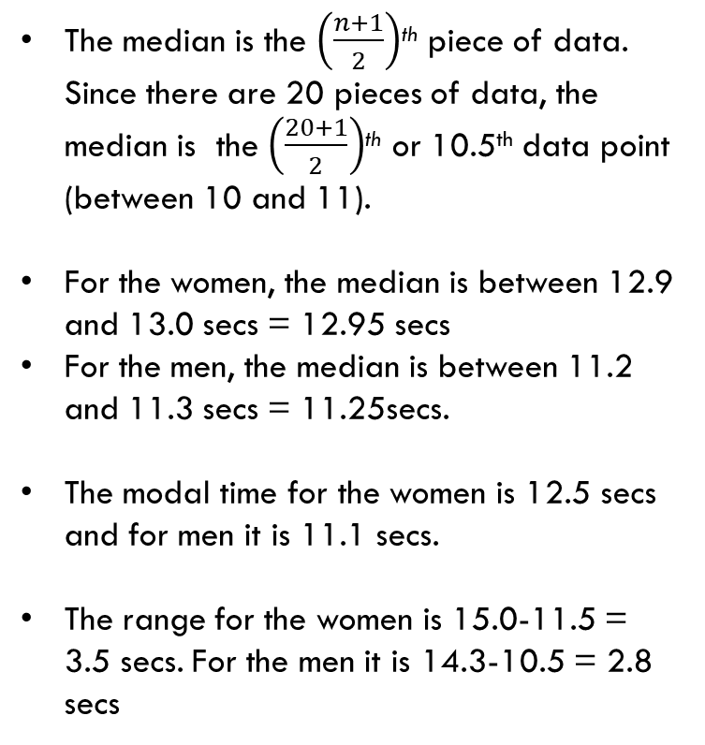
Looking at our 100m data sets, how can we find the median, mode and range of two data sets?
The median is the $\left(\frac{n+1}{2}\right)$^{th} piece of data. Since there are 20 pieces of data, the median is the $\left(\frac{20+1}{2}\right)$^{th} or 10.5th data point (between 10 and 11).
For the women, the median is between 12.9 and 13.0 secs = 12.95 secs
For the men, the median is between 11.2 and 11.3 secs = 11.25secs.
The modal time for the women is 12.5 secs and for men it is 11.1 secs.
The range for the women is 15.0-11.5 = 3.5 secs. For the men it is 14.3-10.5 = 2.8 secs
KEY
11|9 = 11.9 secs
WOMEN
MEN
Leaf
Stem
Leaf
9 5
9 9 7 6 5 5 5 3
8 8 4 3 1 0 0
7 4
0
10 5 7 8 9
0 1 1 1 2 2 3 5 7 8
12 1 3 6
13 0 1
3
10th
11th
10th
11th

Slide 10
LHS:
Here are the ages of patients on admission to a hospital
Males: 2 13 24 39 45 45 48 56 58 59 59 62 64 64 68 69
Females: 1 12 14 23 28 37 39 39 42 42 45 46 51 57 58 63 65 71 88
1) Sort the data into a back-to-back Stem and Leaf Plot. Remember to include a key!
0
1
2
3
4
5
6
7
8

Slide 11
Stem and Leaf Diagrams
Here are the ages of patients on admission to a hospital
Males: 2 13 24 39 45 45 48 56 58 59 59 62 64 64 68 69
Females: 1 12 14 23 28 37 39 39 42 42 45 46 51 57 58 63 65 71 88
2
3
4
9
8 5 5
9 9 8 6
9 8 6 4 4 2
1
2 4
3 8
7 9 9
2 2 5 6
1 7 8
3 5
1
8
0
1
2
3
4
5
6
7
8
4|2 = 52

Slide 12
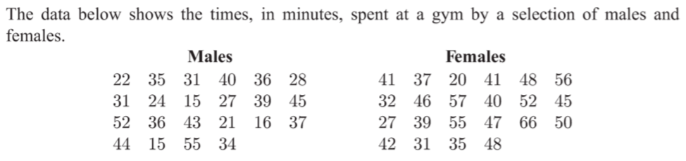
LHS:
Display this data in a back to back stem and leaf plot
How many males spent less than 30 mins at the gym?
Find the median time spent at the gym for both males and females
In general, did males or females spend longer at the gym?

